Slide 1



Presented by
Leveraging on
natural language processing insights
&
improved client-banker interactions
to enhance wealth management solutions
Notes:
Gd morning everyone, we are team alphalab. we have come up with a one stop app, Investr, that leverages on two key components, natural language processing insights and improved client-banker interactions, with an ultimate goal of enhancing wealth management solutions for the client.

Slide 2







Problem
Leveraging on natural language processing insights to improve client-banker relations
Lack of reliable information on investment opportunities
Lack of credible foresights on future changes
Limited Banker Support for Clients (Lack of direct access)
Lack of centralised logging systems for investment transactions
Market Gap: Readily available wealth management solutions that is effective, creating an opportunity for us to explore products and services that would nurture a conducive investing environment for clients.
Notes:
SOlutions
improve accuracy and precision
personalized. other than trade can see some analysis. more centralized instead of finding a banker
one stop platform
investment opportunities, self help
after start, insight into portfolio.
stems from 4 key problems
how portfolio, other trading apps only show portfolio. current analysis of own portfolio not really there
one app. risk analysis. centralised problems when too many with different stuff
three pillars
lack of reliable information on investment opportunities and traps. educations
not much focused predictions in the market with predictions being segregated all over. lack of fundamental accuracy. biased predictions. guts. educated prediction based o……..
lack of portfolio analysis feature for most mass market app, most apps are focused on either transactions or insights
limited direct support from someone with insights about my specific portfolio

Slide 3




Unique Value Proposition (UVP)
What makes us different?
Real-time communication between bankers and clients
Portfolio tracking capabilities with aggregation view
Real-time investment information
Multi-Layered analysis
Notes:
1. https://www.bayshore.ca/resources/demand-for-physiotherapy-will-rise-as-the-population-ages/ (Paragraph 1,2,3)
2. https://www.ncbi.nlm.nih.gov/pmc/articles/PMC2923776/ (Paragraph 1 of introduction)
3. https://orsmi.com/orsblog/cost-of-physical-therapy (The Higher Price Of Not Going To Physical Therapy)
4. https://www.sciencedirect.com/science/article/pii/s1658361216000056 (Paragraph 1)
5. https://www.datapine.com/kpi-examples-and-templates/healthcare#patient-wait-time (Patient Wait Time, Decrease Patients’ Waiting Time)

Slide 4
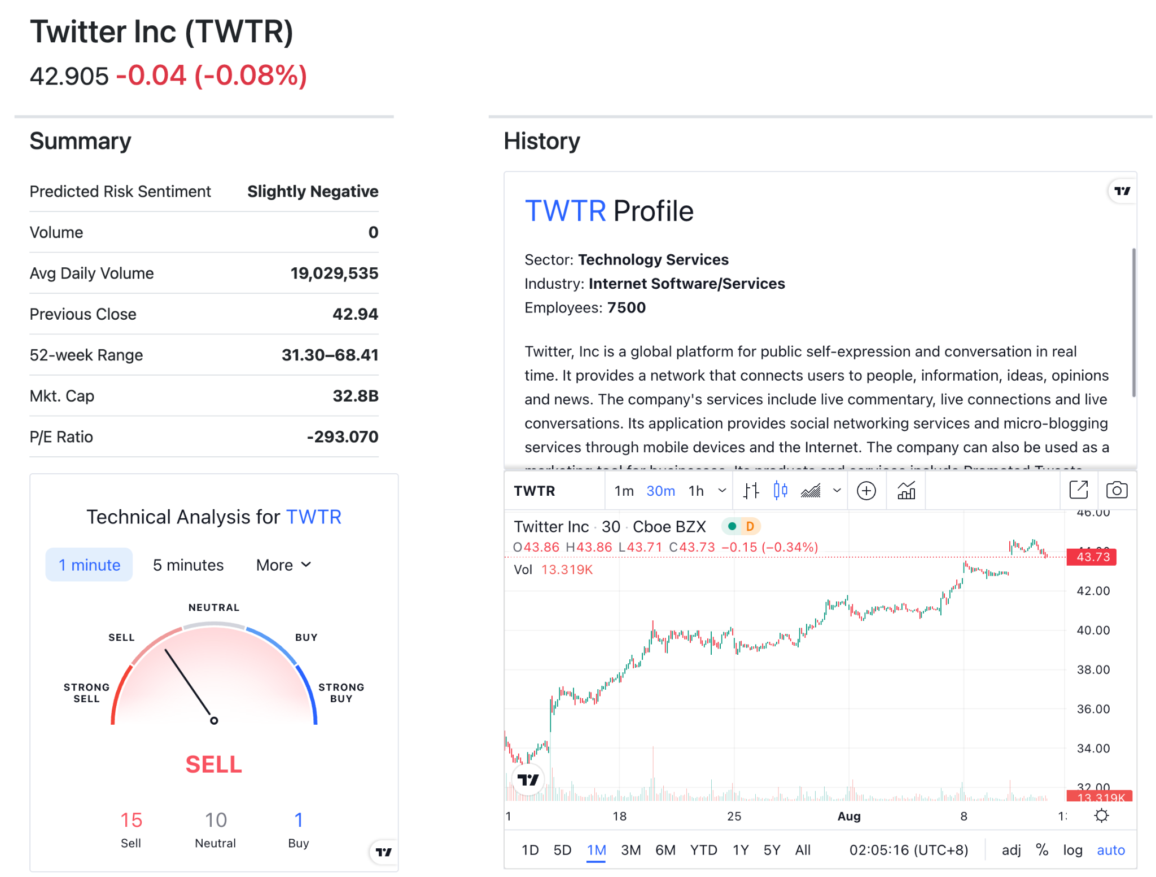
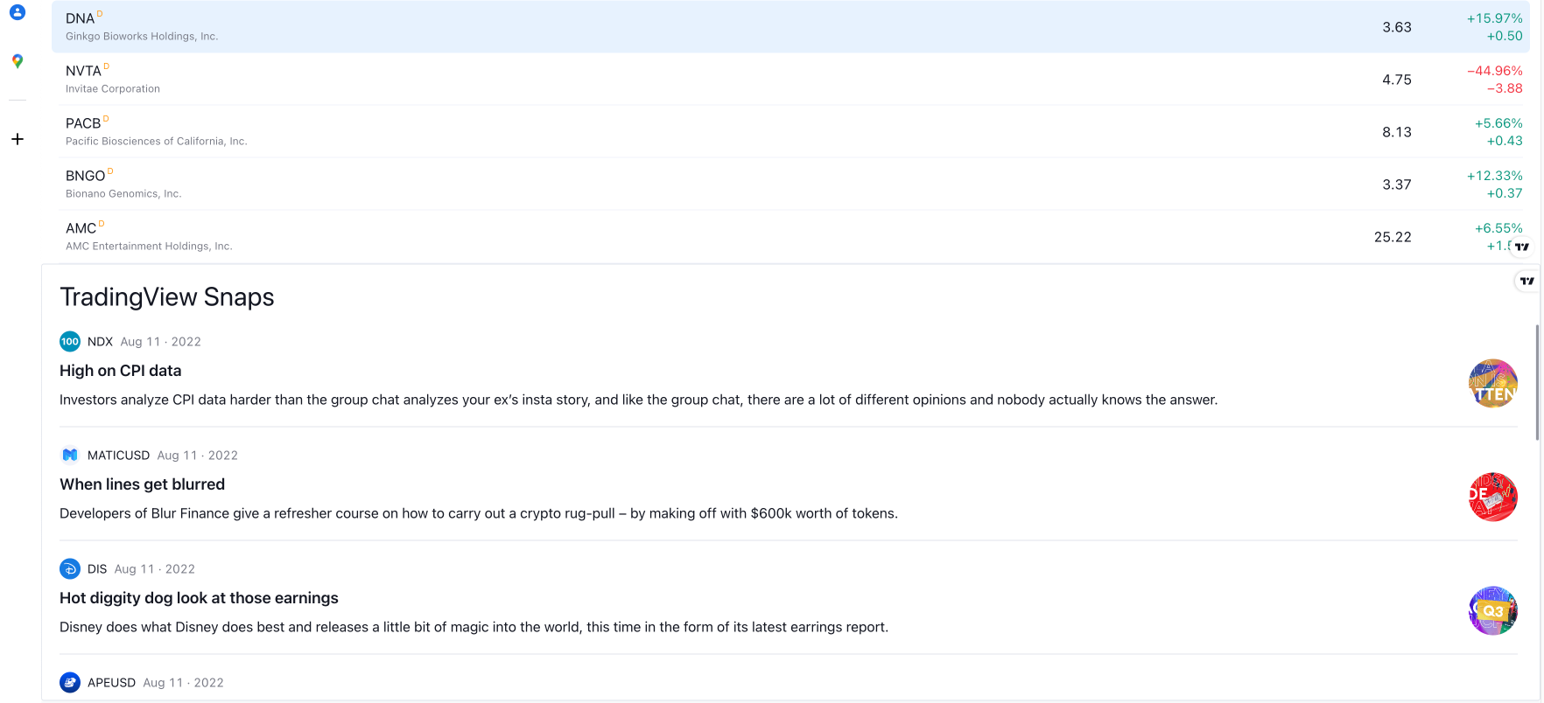
Unique Value Proposition (UVP)
What makes us different?
Real-time investment information
Stock Summary and History
Stock News, Winners and Losers
Notes:
1. https://www.bayshore.ca/resources/demand-for-physiotherapy-will-rise-as-the-population-ages/ (Paragraph 1,2,3)
2. https://www.ncbi.nlm.nih.gov/pmc/articles/PMC2923776/ (Paragraph 1 of introduction)
3. https://orsmi.com/orsblog/cost-of-physical-therapy (The Higher Price Of Not Going To Physical Therapy)
4. https://www.sciencedirect.com/science/article/pii/s1658361216000056 (Paragraph 1)
5. https://www.datapine.com/kpi-examples-and-templates/healthcare#patient-wait-time (Patient Wait Time, Decrease Patients’ Waiting Time)

Slide 5
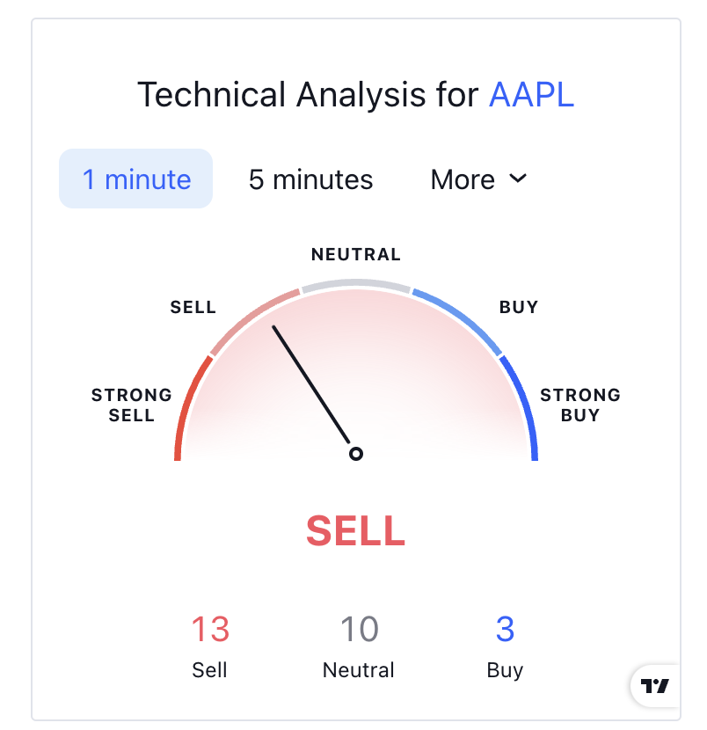
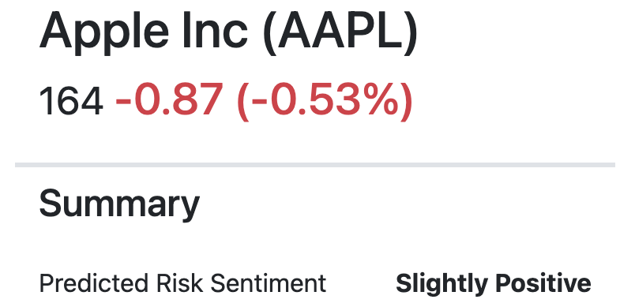
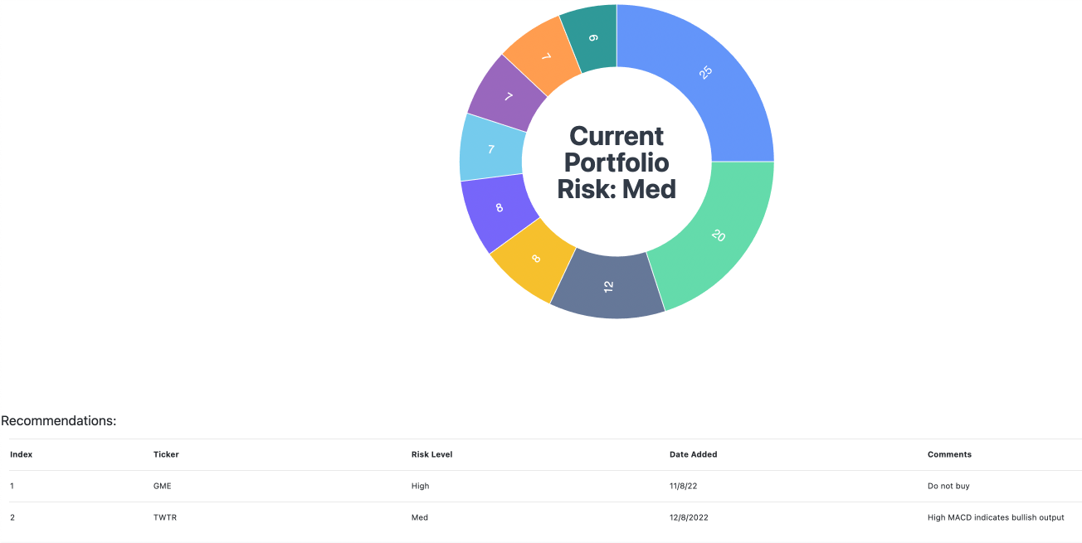
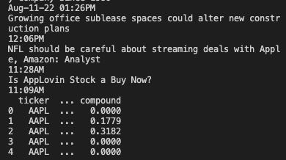
Unique Value Proposition (UVP)
What makes us different?
Multi-Layered analysis
Technical analysis
Sentiment analysis
Banker’s analysis
Notes:
1. https://www.bayshore.ca/resources/demand-for-physiotherapy-will-rise-as-the-population-ages/ (Paragraph 1,2,3)
2. https://www.ncbi.nlm.nih.gov/pmc/articles/PMC2923776/ (Paragraph 1 of introduction)
3. https://orsmi.com/orsblog/cost-of-physical-therapy (The Higher Price Of Not Going To Physical Therapy)
4. https://www.sciencedirect.com/science/article/pii/s1658361216000056 (Paragraph 1)
5. https://www.datapine.com/kpi-examples-and-templates/healthcare#patient-wait-time (Patient Wait Time, Decrease Patients’ Waiting Time)

Slide 6
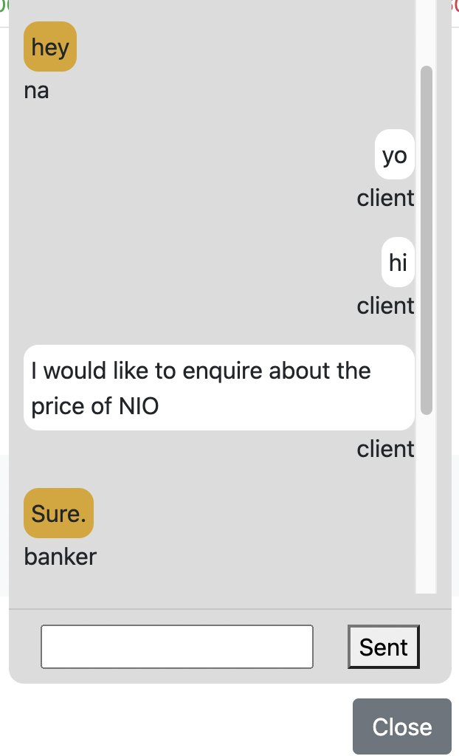
Unique Value Proposition (UVP)
What makes us different?
Real-time communication between bankers and clients
Chat between Client and Banker
Notes:
1. https://www.bayshore.ca/resources/demand-for-physiotherapy-will-rise-as-the-population-ages/ (Paragraph 1,2,3)
2. https://www.ncbi.nlm.nih.gov/pmc/articles/PMC2923776/ (Paragraph 1 of introduction)
3. https://orsmi.com/orsblog/cost-of-physical-therapy (The Higher Price Of Not Going To Physical Therapy)
4. https://www.sciencedirect.com/science/article/pii/s1658361216000056 (Paragraph 1)
5. https://www.datapine.com/kpi-examples-and-templates/healthcare#patient-wait-time (Patient Wait Time, Decrease Patients’ Waiting Time)

Slide 7
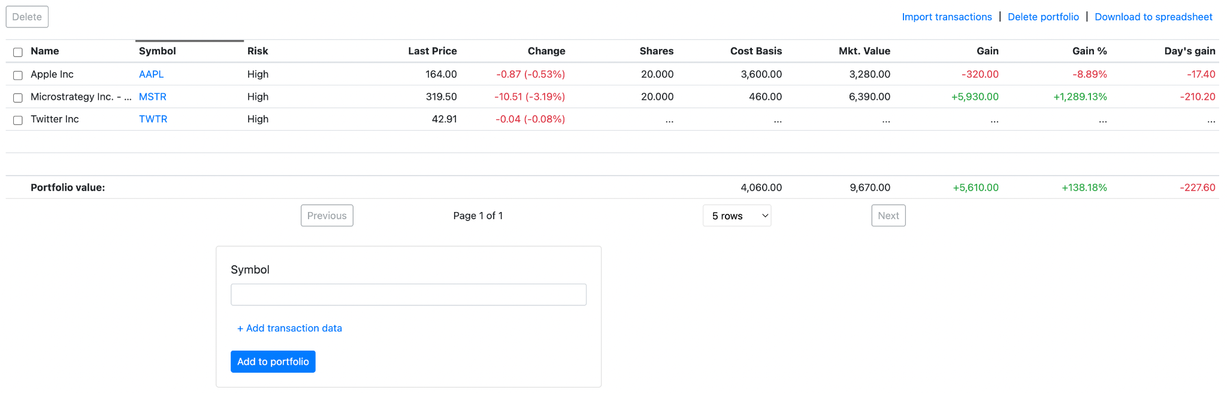
Unique Value Proposition (UVP)
What makes us different?
Portfolio tracking capabilities with aggregation view
Portfolio logging
Notes:
1. https://www.bayshore.ca/resources/demand-for-physiotherapy-will-rise-as-the-population-ages/ (Paragraph 1,2,3)
2. https://www.ncbi.nlm.nih.gov/pmc/articles/PMC2923776/ (Paragraph 1 of introduction)
3. https://orsmi.com/orsblog/cost-of-physical-therapy (The Higher Price Of Not Going To Physical Therapy)
4. https://www.sciencedirect.com/science/article/pii/s1658361216000056 (Paragraph 1)
5. https://www.datapine.com/kpi-examples-and-templates/healthcare#patient-wait-time (Patient Wait Time, Decrease Patients’ Waiting Time)

Slide 8
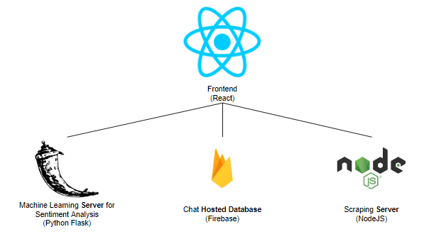
Tech
Tech Stack
Notes:
modules:
python flask: machine learning server to conduct sentiment analysis
firebase: chat backend and database
nodejs: server to scrape for stock betas
react so it can relay info directly to the user on the app layer

Slide 9
App Demo
Live walkthrough of
Notes:
1. https://www.bayshore.ca/resources/demand-for-physiotherapy-will-rise-as-the-population-ages/ (Paragraph 1,2,3)
2. https://www.ncbi.nlm.nih.gov/pmc/articles/PMC2923776/ (Paragraph 1 of introduction)
3. https://orsmi.com/orsblog/cost-of-physical-therapy (The Higher Price Of Not Going To Physical Therapy)
4. https://www.sciencedirect.com/science/article/pii/s1658361216000056 (Paragraph 1)
5. https://www.datapine.com/kpi-examples-and-templates/healthcare#patient-wait-time (Patient Wait Time, Decrease Patients’ Waiting Time)

